Slide 1

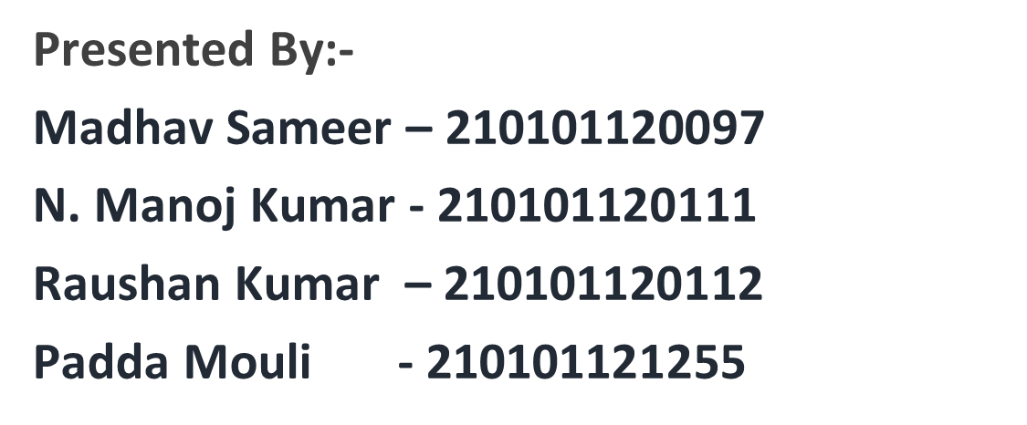
Submitted to:-Prof. Manaswini Padhy

Slide 2
Introduction to Online Examination System
An online examination system is a platform that allows users to register, login, and attempt multiple-choice questions (MCQ). It provides a convenient and efficient way for students and professionals to take exams remotely.

Slide 3
Overview of HTML, CSS, and PHP
HTML (HyperText Markup Language)
CSS (Cascading Style Sheets)
PHP (Hypertext Preprocessor)
HTML is the standard markup language for creating web pages and web applications.
CSS is used to describe the presentation of a document written in HTML.
PHP is a server-side scripting language designed for web development.
It enables the separation of content from presentation, making web pages more visually appealing.
It is used to create dynamic web pages and interact with databases.
It provides the structure and layout of the content on the web page.

Slide 4
User Registration Process
Create an Account
Validation & Verification
Ensure data accuracy by validating and verifying user information.
Security Measures
Implement robust security measures to protect user data and privacy.
Users can easily create a new account by providing basic information.

Slide 5
User login process
1
Account Credentials
Users enter their username and password to access the system.
2
Security Measures
Implemented to ensure the safety of user data and privacy.
3
Authentication
System verifies the user's credentials and grants access upon successful authentication.

Slide 6
Designing the MCQ Interface
When creating the multiple choice question (MCQ) interface, the focus is on intuitive design and user-friendly interaction. Utilize clear visual elements, logical question flow, and responsive layout to engage users.
Consider incorporating multimedia elements, such as images and diagrams, to enhance the learning experience. Optimize the interface for various devices and screen sizes for a seamless user experience.

Slide 7
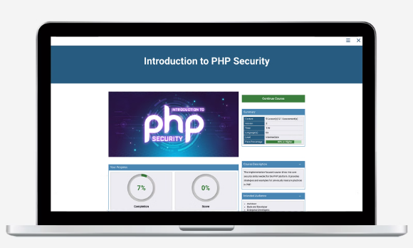
Storing User Data Using PHP
When a user registers or logs in, their data needs to be securely stored in a database. PHP provides robust features to manage user data, including encryption for sensitive information.
By implementing PHP's database functionality, user data can be organized, accessed, and managed efficiently, ensuring a seamless experience for users.

Slide 8
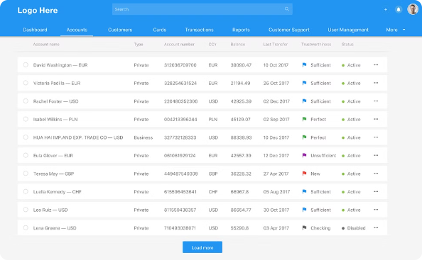

Retrieving and displaying user attempts
User Attempt Dashboard
Efficient Data Retrieval
Users can easily access and view their previous exam attempts in a simplified dashboard.
The system quickly retrieves and organizes user attempt data for seamless viewing.

Slide 9
Implementing Security Measures
Secure Login: Implement multi-factor authentication for user login.
Encryption: Use strong encryption algorithms to protect user data.
Regular Audits: Conduct regular security audits to identify and fix vulnerabilities.

Slide 10
Testing and debugging
Comprehensive Testing
Thoroughly test the functionality of the online examination system to identify and fix any bugs or errors.
Browser Compatibility
Ensure that the system functions seamlessly across different web browsers to provide a consistent user experience.
Data Integrity Checks
Implement measures to validate and maintain the integrity of user data and exam results throughout the system.
Error Handling and Logging
Set up robust error handling processes and logging mechanisms to track system issues and maintain performance.

Slide 11
Conclusion and Future Enhancements
As the online examination system nears completion, future enhancements could include integration with virtual proctoring services to ensure exam integrity. Additionally, implementing a feedback system for users to provide their experience and suggestions would enhance the platform's user-friendliness. Expanding the question types beyond MCQs could further diversify the assessment methods.

Slide 12
____________________
________________
Thank you
________________
____________________

